Slide 1
Honors in Machine Learning and Artificial Intelligence Mini Project Evaluating the performance of Deep Reinforcement Learning for solving the Cartpole Problem
Aboli Marathe
Roll No. 41301 | PRN. 71900008E | be 3
Department Of Computer Engineering
Pune Institute Of Computer Technology

Slide 2
Introduction
Reinforcement learning is an area of machine learning concerned with how intelligent agents ought to take actions in an environment in order to maximize the notion of cumulative reward.

Slide 3
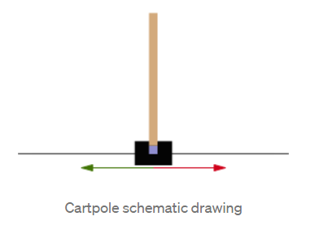
Cartpole problem
Cartpole - known also as an Inverted Pendulum is a pendulum with a center of gravity above its pivot point. It’s unstable but can be controlled by moving the pivot point under the center of mass. The goal is to keep the cartpole balanced by applying appropriate forces to a pivot point.

Slide 4
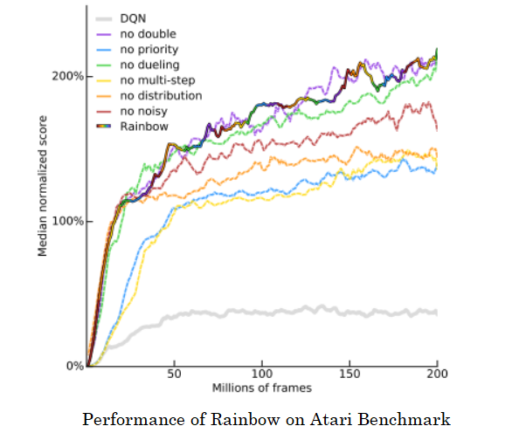
Rainbow
A selection of the below six extensions that each have addressed a limitation and improved overall performance were integrated into a single integrated agent, Rainbow for improved performance on RL tasks [8]:
1. Double Q-learning
2. Prioritized replay
3. Dueling networks
4. Multi-step learning
5. Distributional RL
6. Noisy Nets

Slide 5
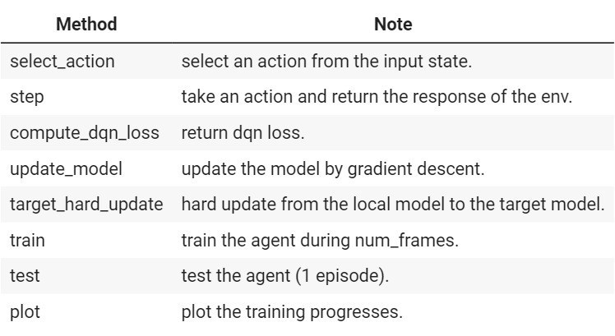
Rainbow Agent

Slide 6
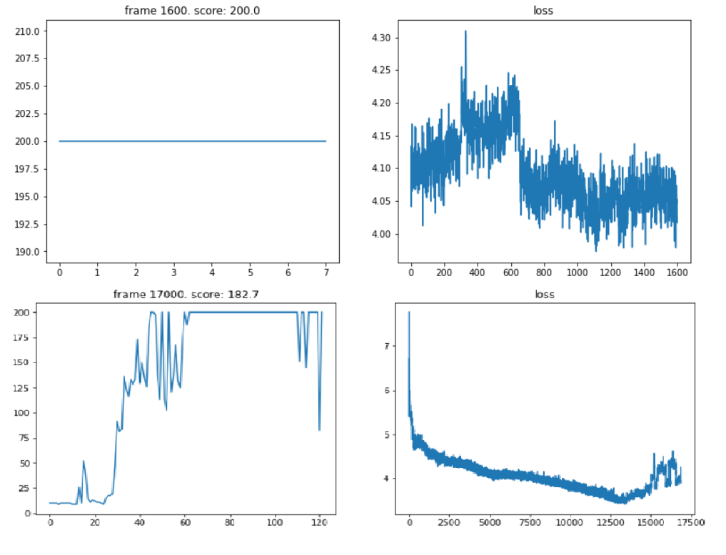
Training

Slide 7
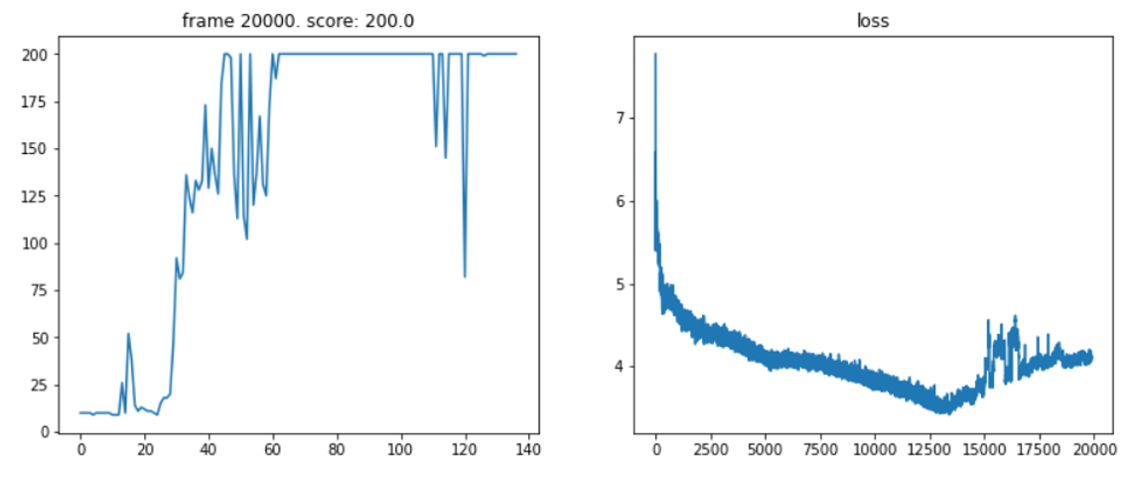
Results

Slide 8
Conclusion
The model is able to reach a score of 200 with a minimal training time of 5 minutes. We selected a small sample of training to demonstrate in the project and showed the model after training during this period.
Thus in this project we have applied and demonstrated the efficiency of the Rainbow method of Reinforcement Learning and used it for solving the cartpole problem.
The final video and performance of model can be seen in next slide and is attached as a part of the submission.

Slide 9
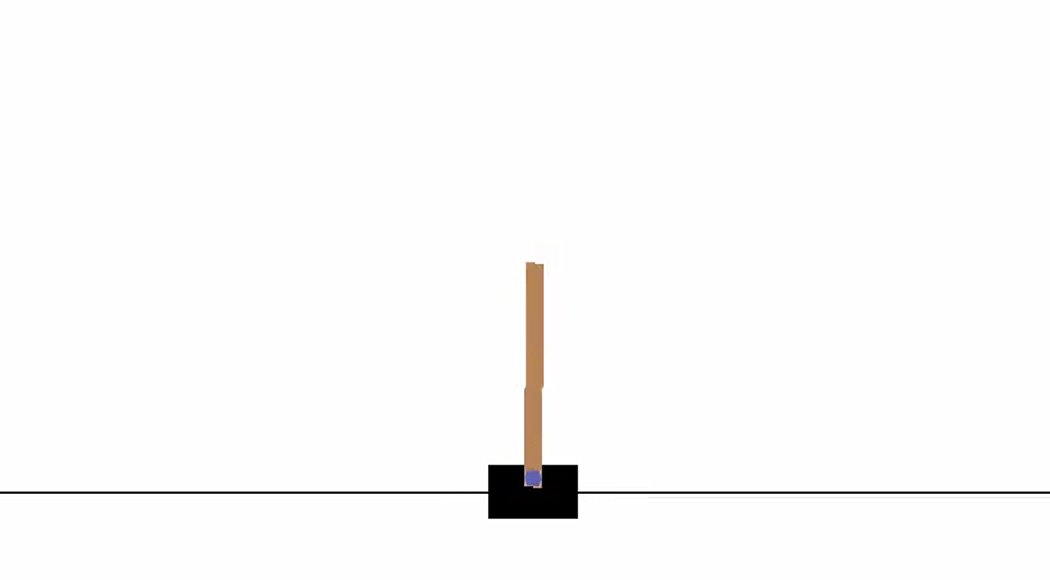

Slide 10
References
1. V. Mnih et al., "Human-level control through deep reinforcement learning." Nature, 518 (7540):529–533, 2015.
2. van Hasselt et al., "Deep Reinforcement Learning with Double Q-learning." arXiv preprint arXiv:1509.06461, 2015.
3. T. Schaul et al., "Prioritized Experience Replay." arXiv preprint arXiv:1511.05952, 2015.
4. Z. Wang et al., "Dueling Network Architectures for Deep Reinforcement Learning." arXiv preprint arXiv:1511.06581, 2015.
5. M. Fortunato et al., "Noisy Networks for Exploration." arXiv preprint arXiv:1706.10295, 2017.
6. M. G. Bellemare et al., "A Distributional Perspective on Reinforcement Learning." arXiv preprint arXiv:1707.06887, 2017.
7. R. S. Sutton, "Learning to predict by the methods of temporal differences." Machine learning, 3(1):9–44, 1988.
8. M. Hessel et al., "Rainbow: Combining Improvements in Deep Reinforcement Learning." arXiv preprint arXiv:1710.02298, 2017.
9. https://github.com/Curt-Park/rainbow-is-all-you-need
10. Mnih, Volodymyr, et al. "Playing atari with deep reinforcement learning." arXiv preprint arXiv:1312.5602 (2013).

